Slide 1

MARKET RESEARCH REPORT on Tesla
MARKET RESEARCH
REPORT ON TESLA
SWOT Analysis , Target audience, Competitors, and Market trends
Date : June 2026
SWOT Analysis, Target audience, Competitors, and Market trends
Date : June 2026

Slide 2
INTRODUTION OF TESLA
Introduction of Tesla
Tesla is one of the world’s leading electric vehicle (EV) and clean energy companies. Founded by Elon Musk and others, Tesla focuses on sustainable transportation, battery technology, solar energy, and innovation. The company has transformed the automobile industry through advanced electric cars, autonomous driving technology, and a strong brand image.
This report analyzes Tesla’s SWOT analysis, target audience, competition, and current market trends.
Tesla is one of the world’s leading electric vehicle (EV) and clean energy companies. Founded by Elon Musk and others, Tesla focuses on sustainable transportation, battery technology, solar energy, and innovation. The company has transformed the automobile industry through advanced electric cars, autonomous driving technology, and a strong brand image.
This report analyzes Tesla’s SWOT analysis, target audience, competition, and current market trends.

Slide 3
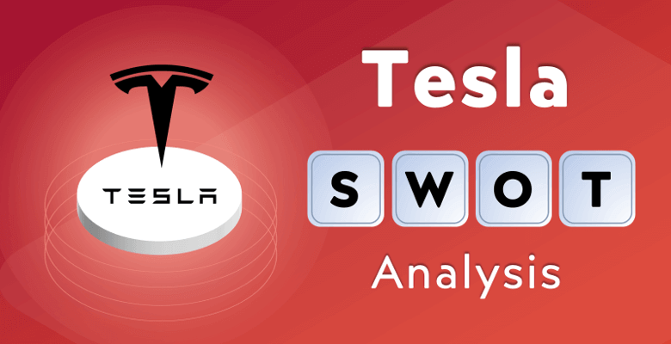

Slide 4
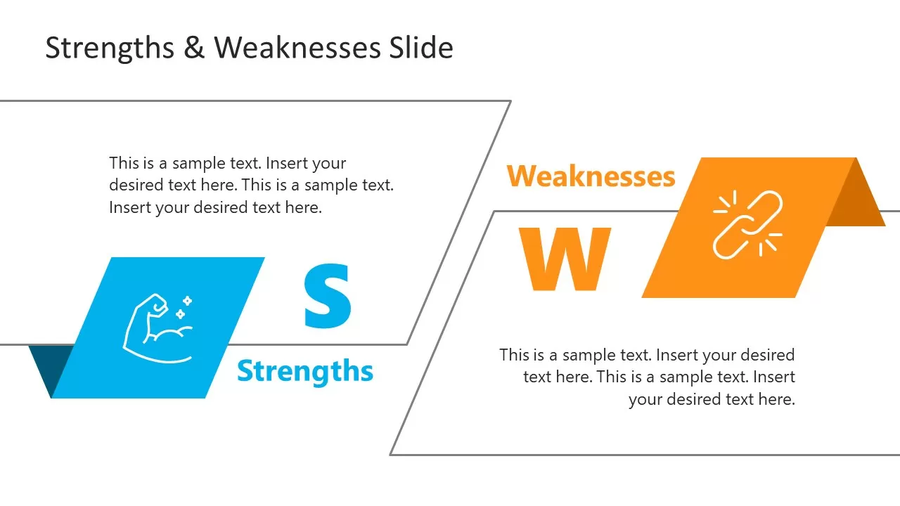
Strengths & Weakness
1. Strong Brand Image
2. Technological Innovation
3. Global Market Presence
4. Sustainability Focus
5. High Customer Loyalty
1. High Product Prices
2. Limited Service Centers
3. Production Delays
4. Dependence on Elon Musk

Slide 5
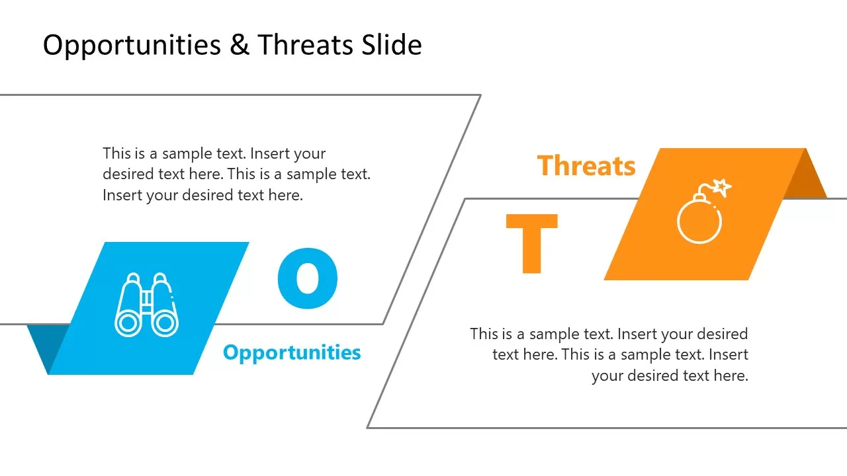
Opportunities & Threats
1. Growing EV Demand
2. Strong Brand Value
3. Renewable Energy Business
4. Autonomous Driving Technology
1. Increasing Competition
2. Government Regulations
3. Supply Chain Issues
4. Economic Uncertainty

Slide 6
2. Target Audience of Tesla
2. Target Audience of Tesla
Tesla targets customers who value innovation, sustainability, and premium technology.
Primary Target Audience
Environmentally conscious consumers
High-income individuals
Technology enthusiasts
Luxury car buyers
Young professionals and entrepreneurs
Tesla targets customers who value innovation, sustainability, and premium technology.
Primary Target Audience
Environmentally conscious consumers
High-income individuals
Technology enthusiasts
Luxury car buyers
Young professionals and entrepreneurs

Slide 7
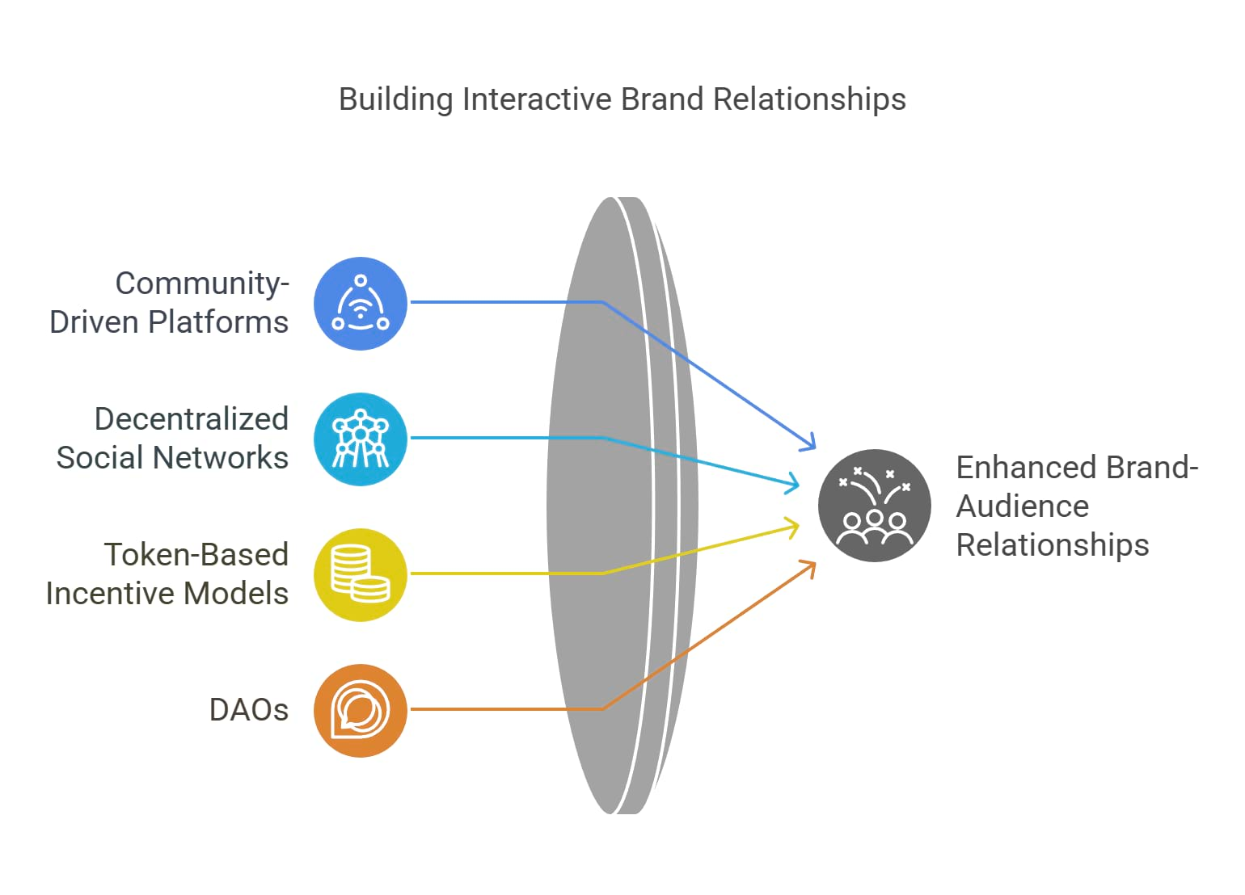

Who Buys Tesla
Felt Owners
Consumers …w/purchasing …Power
Tesla’s Target Market
High-Income
…..Professional
Young professionals and entrepreneurs

Slide 8
3. Competitors of Tesla
3. Competitors of Tesla
Tesla faces competition from both traditional automobile companies and emerging EV brands.
Major Competitors
1. BYD
2. BMW
3. Mercedes-Benz
4. Ford Motor Company
5. Rivian
Tesla faces competition from both traditional automobile companies and emerging EV brands.
Major Competitors
BYD
2. BMW
3. NIO
4. Hyundai Motor Groups
5. Toyota

Slide 9
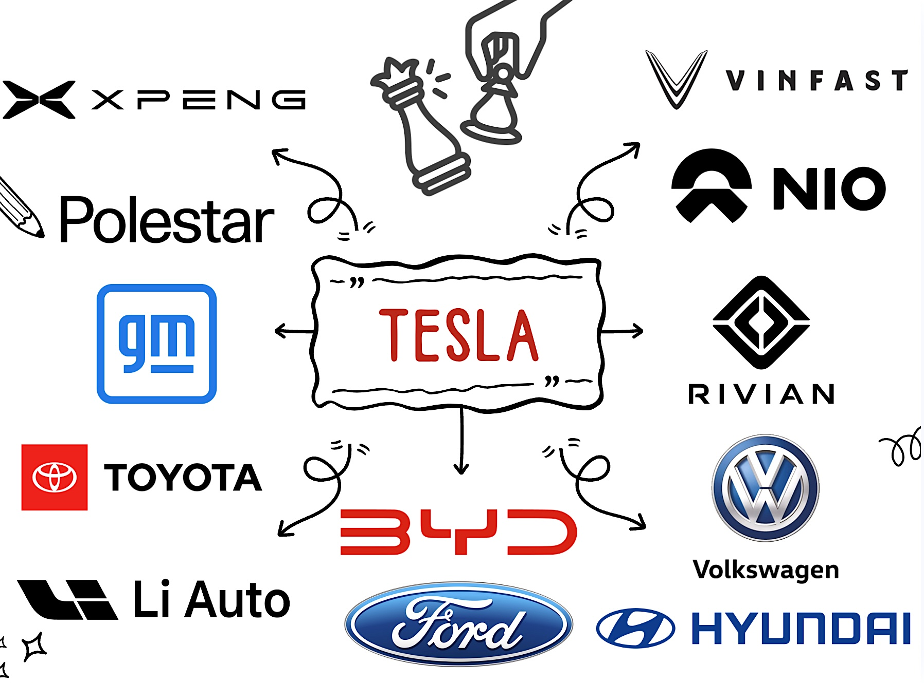

Slide 10
4. Current Market Trends
4. Current Market Trends
1. Rapid Growth of Electric Vehicles
2.Shift Toward Sustainable Transportation
3. Government Incentives
4. AI and Autonomous Driving
5. Expansion of Charging Infrastructure
6.Battery Technology Improvements
1. Growth of Electric Vehicle (EV)
2. Rising Competition
3. Focus on Autonomous Driving
4. AI and Robotic Trends
5. Expansion of Charging Infrastructure
6. Battery Technology Improvements

Slide 11
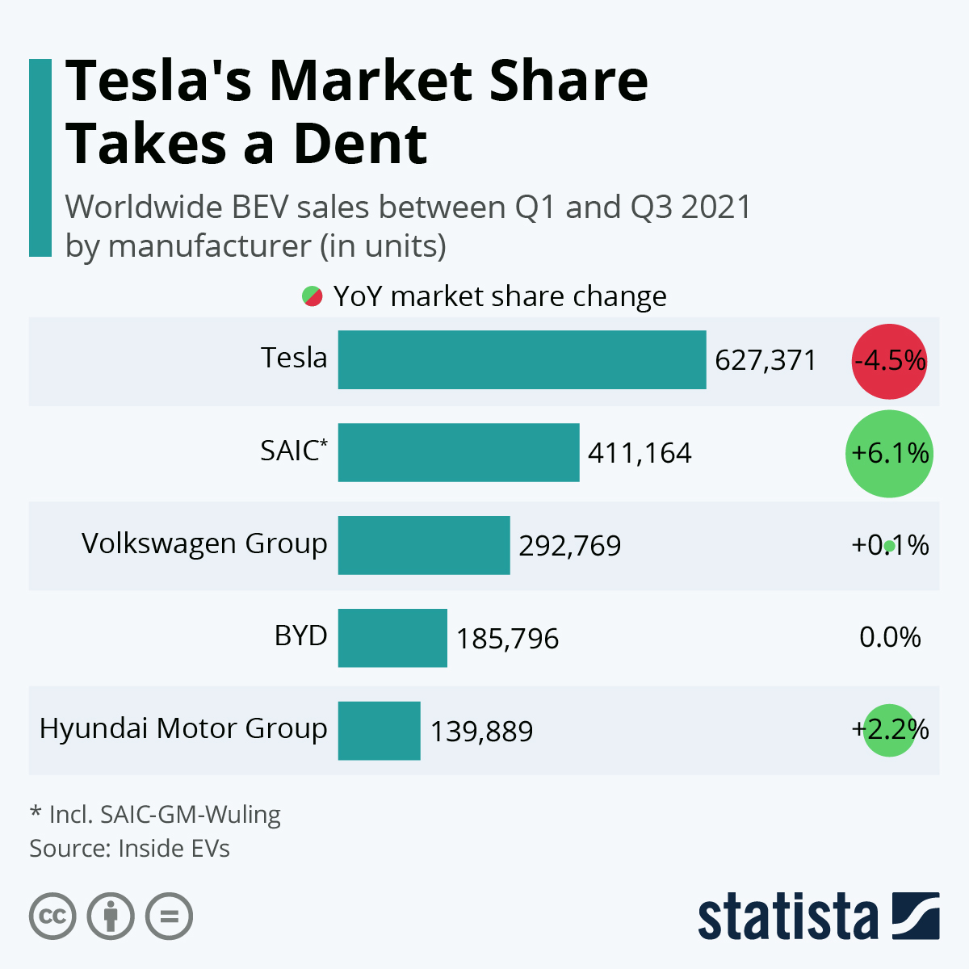
Global EV Market Share
s
Number of Electric Vehicle Sold (2024)
Tesla
627,371
ds

Slide 12
Conclusion
Conclusion
Tesla has become a global leader in the Electric vehicle industry through innovation, strong branding, and sustainable technology. Despite challenges such as rising competition and high production costs, Tesla continues to maintain a competition advantage through advanced technology and customer loyalty. The growing demand for electric vehicles and renewable energy solution provides strong future growth opportunities for the company.
Overall, Tesla’s business strategy and market positioning make it one of the most influential companies in the modern automobile industry.
Tesla has become a global leader in the electric vehicle industry through innovation, strong branding, and sustainable technology. Despite challenges such as rising competition and high production costs, tesla continues to maintain a competition advantage through advanced technology and customer loyalty. The growing demand for electric vehicles and renewable energy solution provides strong future growth opportunities for the company.
Overall, tesla’s business strategy and market positioning make it one of the most influential companies in the modern automobile industry.

Slide 13
Thank You

